Slide 1
Ecological Restoration Technology Innovation
Case studies from Europe
Notes:
Cover page

Slide 2
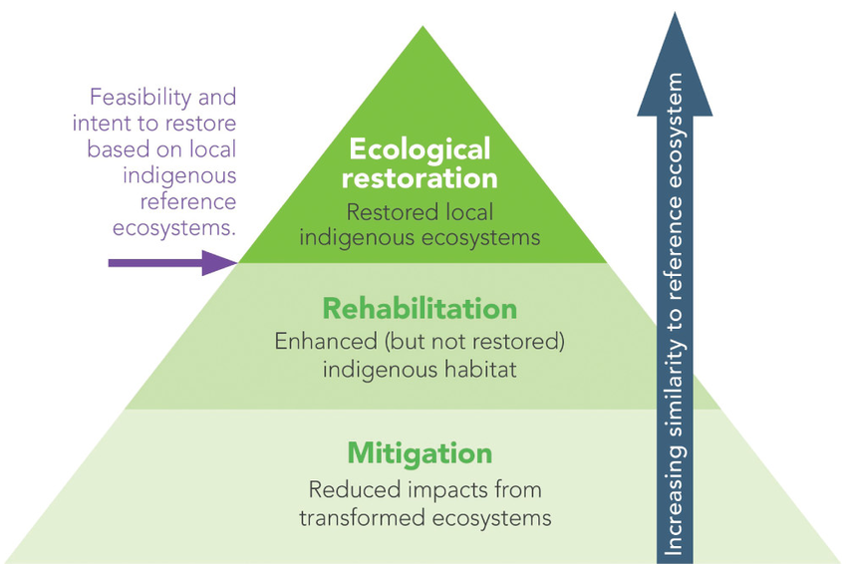
Ecological Restoration
Six key ecosystem attributes to measure progress towards full restoration:
Species composition
Structural diversity (=Community structure)
Ecosystem function
External Exchanges
Absence of threats
Physical conditions
Adapted from McDonald, T., Jonson, J., Dixon, K.W. 2016. National standards for the practice of ecological restoration in Australia. Restoration Ecology 24:S4-S32. DOI: 10.1111/rec.12359

Slide 3





Summary of cases studies
Water Management and Ecological Security
Urban Waters
Rural Waters
Water and Energy

Slide 4
Prioritizing Restoration measures in Algarve
Pre-classification of Ecological Status (PES) based in human pressures – steps:
  Define and categorize human pressures (ki) that potentially affect indicators
  Pressures will be analyzed according to impact on he 3 alteration axes: water quality, hydro-morphology and hydro-connetivity
  Integration pressures in a final value of PES
  Correlation between PES and elements of ecological quality
The variables that produce larger effects are selected to guide the process of prioritizing restoration

Slide 5
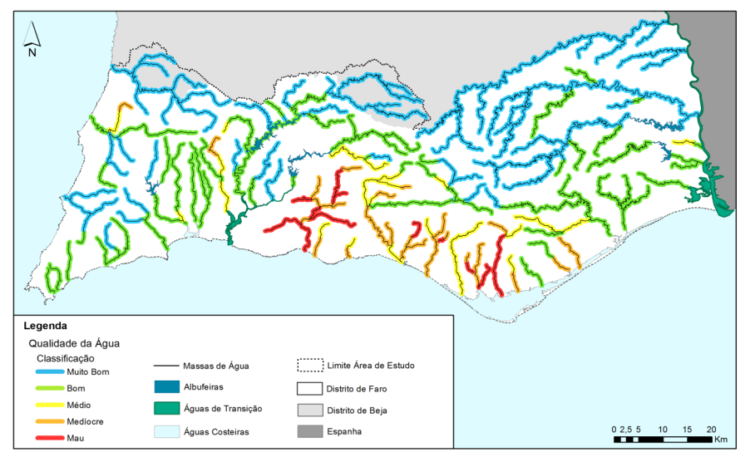
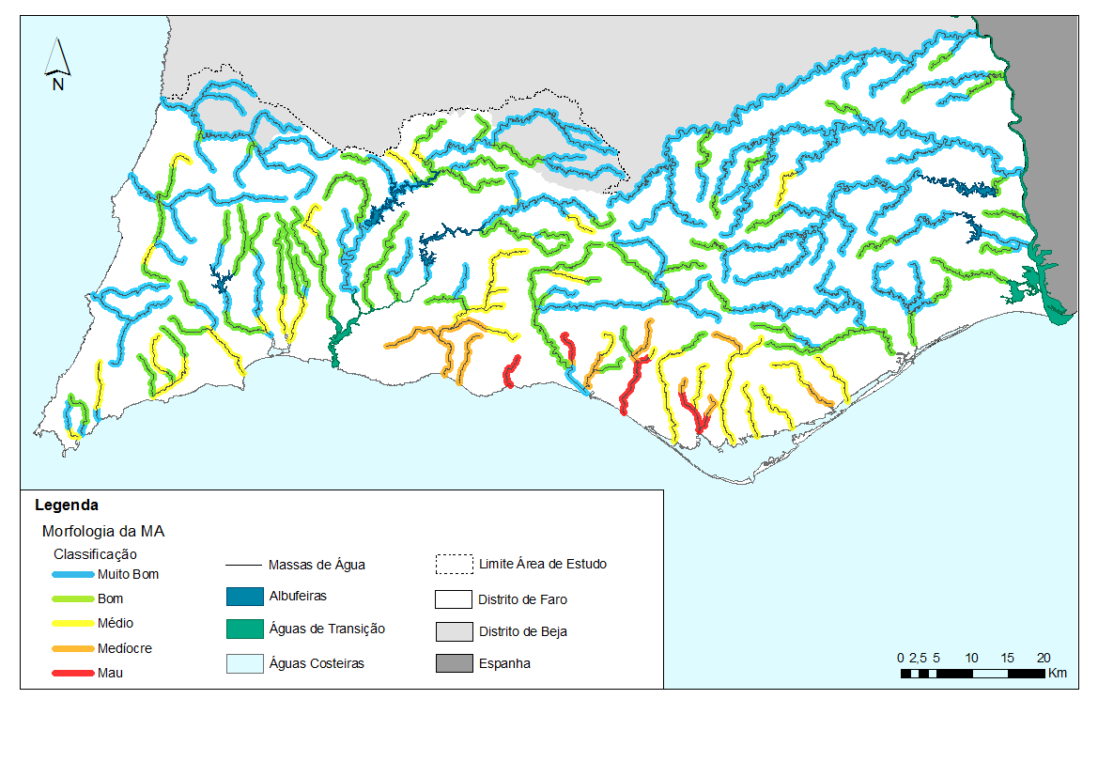
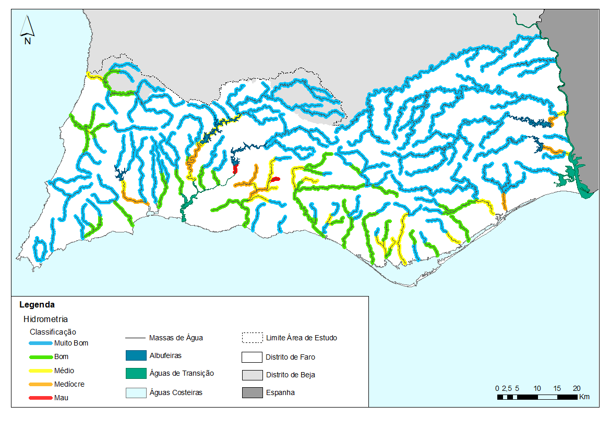
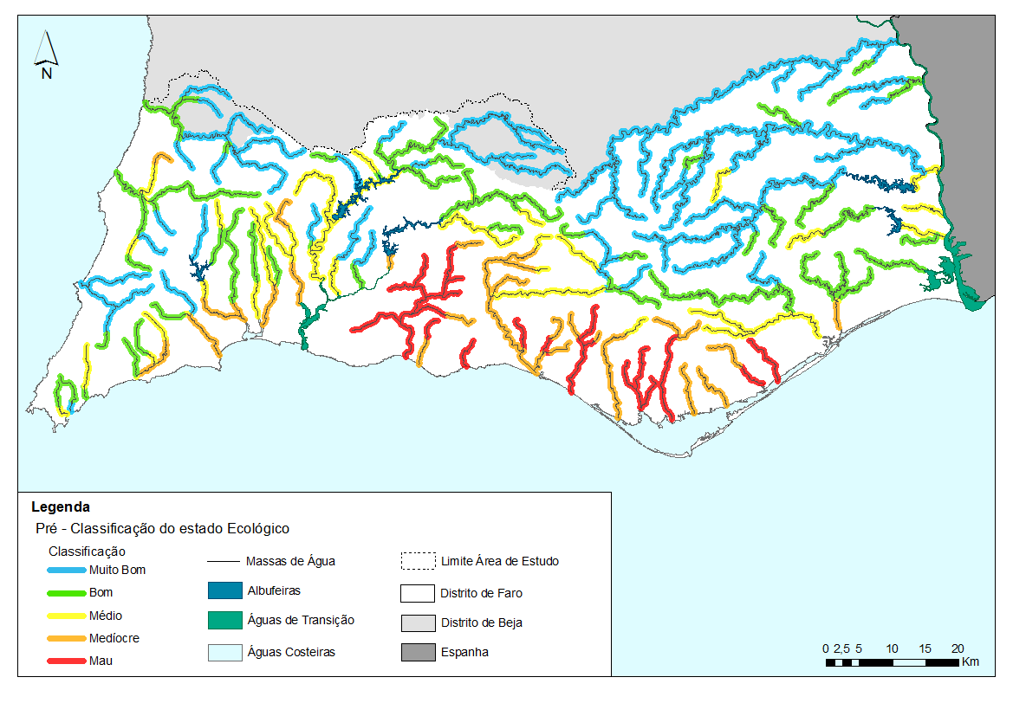

1. Water quality
2. Hydromorphology
3. Hydroconnectivity
PES – pre-classification
Notes:
A Pre-classification of Ecological Status based on human pressures was developed and these are the maps produced according to pressures selected.

Slide 6
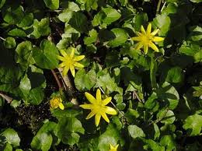
Biological elements of quality WFD
IBMR –index of aquatic vegetation
Describes mainly eutrophisation
Diatoms (CEE, IPIS)
Describes gradients of organic and inorganic pollution
Macro-invertebrates (IPTIN, IPTIS)
Describes gradients of organic degradation and morphological changes
Fish (F-IBIP)
Evaluates fragmentation and ofganic polllution
Notes:
PES was then calibrated with Information gathred fromt he monitoring programs imposed by the WFD.

Slide 7
Linear representation in a confidence interval of 90% of the means of biological quality element with PES.
PES = 9,389 – 5,327 Ecological status
R²= 0,61
The selected pressure are good indicators of resulting ecological quality
Notes:
Each pressure was correlated with biological elements and selected pressures were good indicators of ecological water quality. This was then used to analyse the best management options for the basin having in regard the potential impact on ecological water quality.

Slide 8





Action of measures to improve water quality
Actions | Time to positive impact in biological communities |  |  |  | Costs | Priority ranking
 | Macrophytes | Macroinvert. | Fish | Birds
Nutrient management
Strutural changes in the management of agricultural land
Irrigation and water re-use of run-off
Green buffers in agriculture landscape
River vegetation buffers
Soil bio-engineering techniques
Sand filters and percolation ditches
Retention and water Treatment station system improvement in the watershed
Strutural intervention in the poultry and other animal farming areas
Waste Collection System removal in river corridor
Land acquisition by the state
Definition of ecological flow
Fish pass optimization and fish bypass instalation
Cutting and seeding of natural riparian vegetion
Exotic species control
Restoration of river margins physical structure and erosion control
Soil bio-engineering techniques for river habitat diversification
Animal and flora population control
Native species restocking

Slide 9
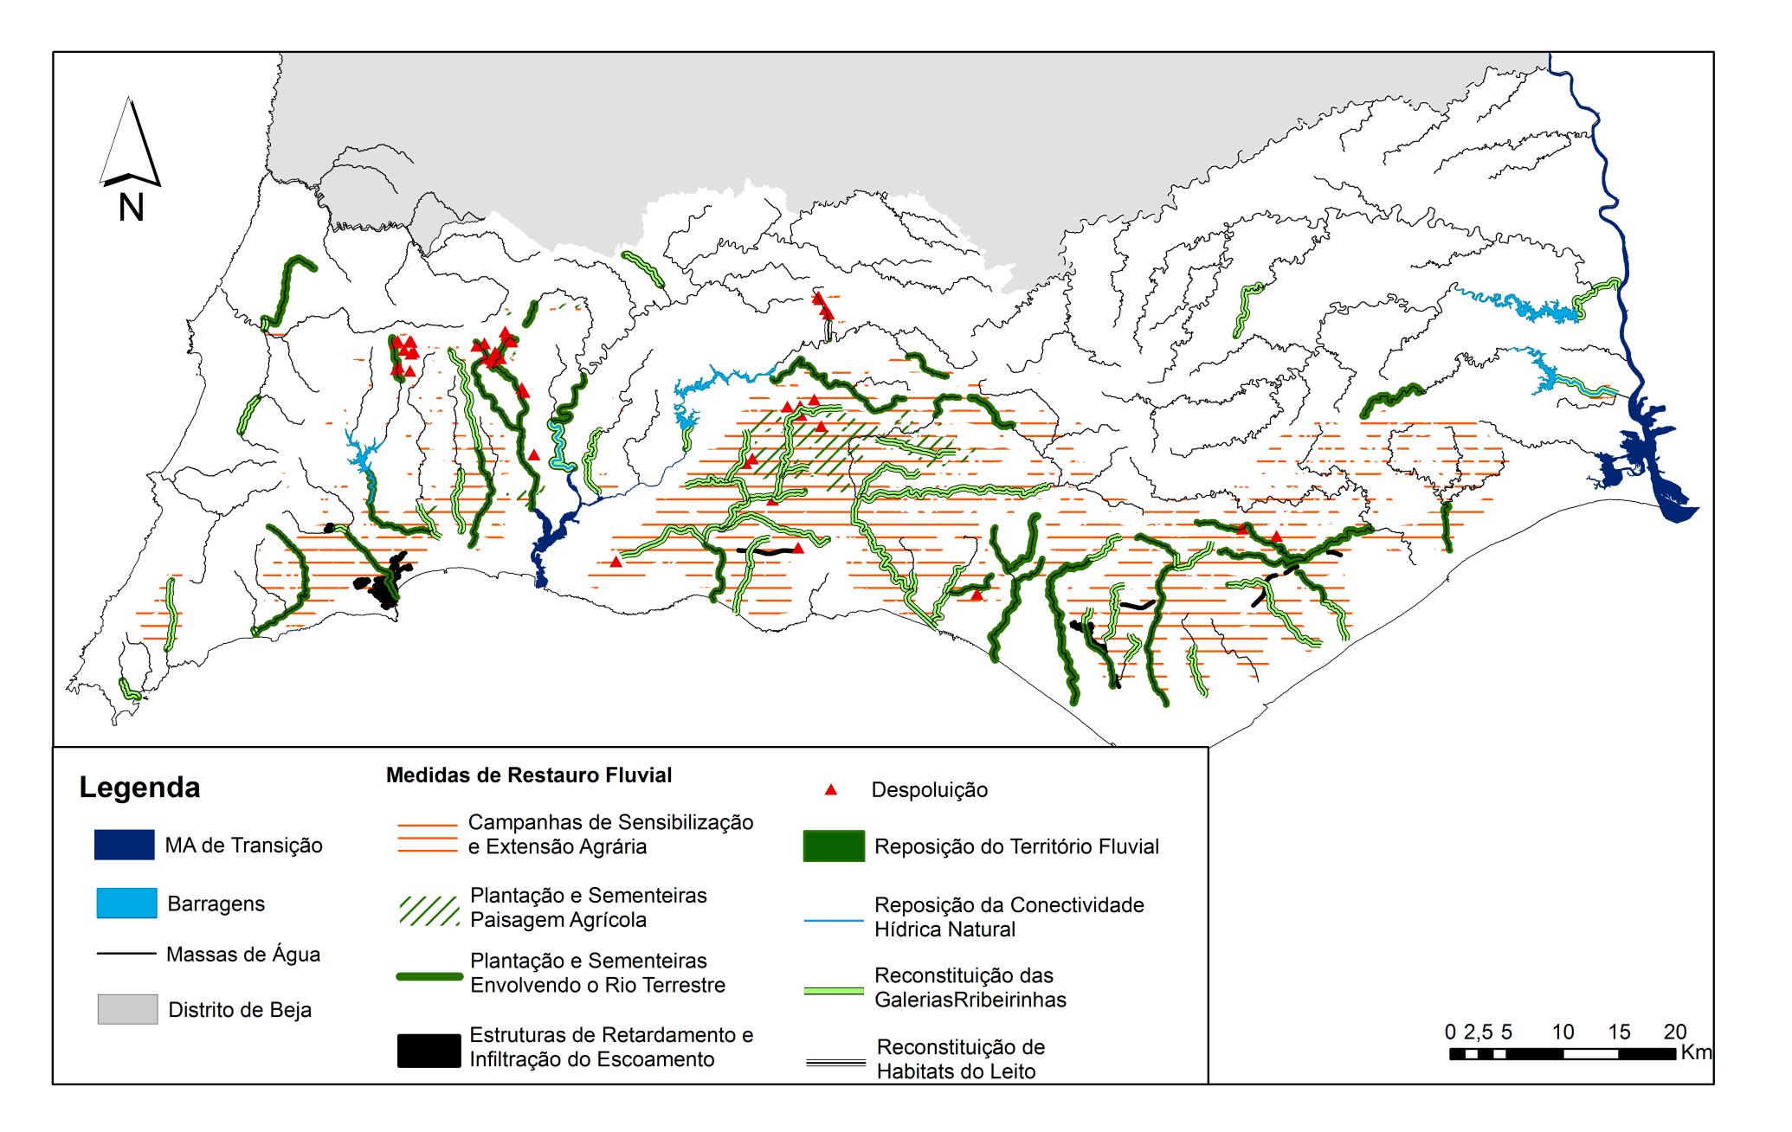
Notes:
Each pressure was correlated with biological elements and selected pressures were good indicators of ecological water quality. This was then used to analyse the best management options for the basin having in regard the potential impact on ecological water quality.

Slide 10

Cost Effective Neural Technique for Alleviation of Urban Flood Risk
CENTAUR project
Waters of Coimbra/University of Coimbra https://www.sheffield.ac.uk/centaur/home/outputs
A flood risk reduction system that aims to reduce local flood risk using a dynamically controlled Flow Control Device (FCD) to utilize the unused storage in sewer networks and piped drainage systems during rainfall events.
It can be installed within manholes with minimal new infrastructure and the FCD is regulated using a data-driven control system. The control system is informed by a local water level sensing system that is an integral part of a CENTAUR system.
Notes:
Text page

Slide 11
Cost Effective Neural Technique for Alleviation of Urban Flood Risk
CENTAUR
First phase - development and integration of the Flow Control Device and Local Monitoring and Control System and the development and integration of the software (communication and control algorithms) needed for this local real time control flood risk reduction system.
Second phase - pilot CENTAUR system has been manufactured and installed in the Av. Júlio Henriques in Coimbra, Portugal.
More information: file:///C:/Users/DBIO/Downloads/CENTAUR_Deliverable3.1_v1.4%20(1).pdf

Slide 12
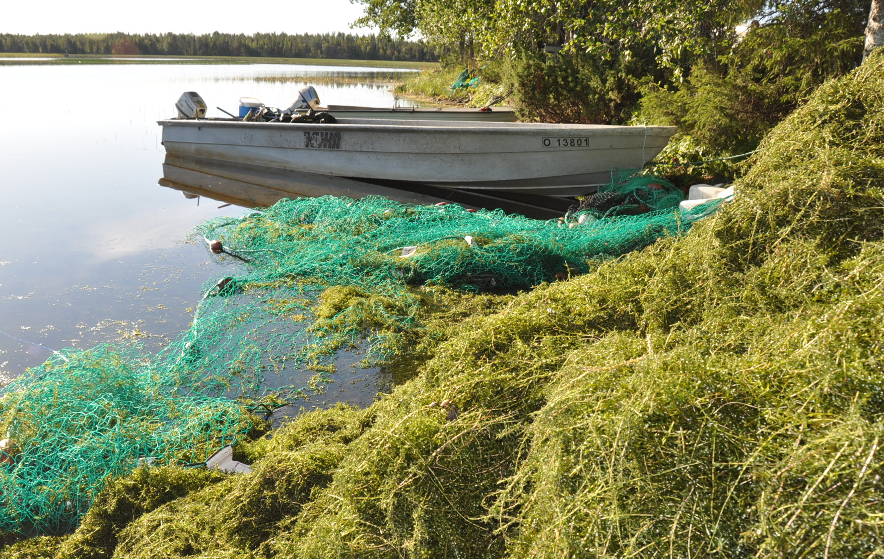



Recycling nutrients and energy of Canadian waterweed
ELODEA II
Ritva Nilivaara, Finnish Environment Institute (SYKE)
Background:
Invasive alien species Canadian waterweed (Elodea canadensis) has spread to hundreds of lakes around Finland.
In favorable growth conditions the massive growth causes severe damages to the ecology and use of the lakes.
The waterweed dominates native macrophyte communities and its decomposition can lead to oxygen depletion and, consequently, to lake’s eutrophication.
Aims:
Finding cost-effective ways to remove the biomass and develop a business model
Pilot testing of biomass utilization as fertilizer or as raw material for biogas production
Examine ecological impacts and develop methods for planning extensive biomass removal
2019-2021
Budget 351 000€
Partners SYKE, LUKE and ProAgria Oulu.
Funded by the European Regional Development Fund

Slide 13
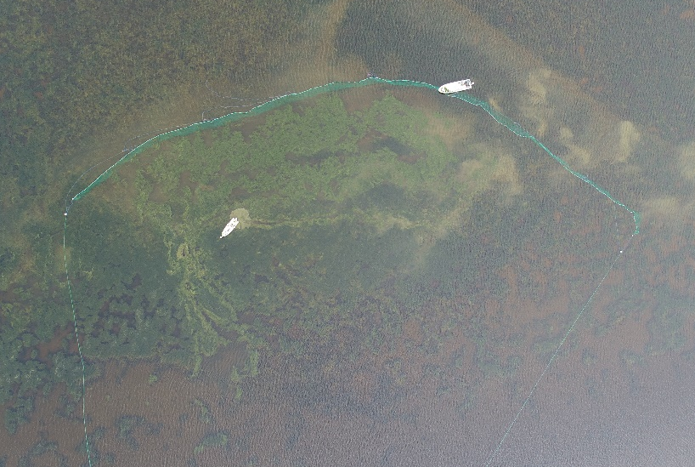
Recycling nutrients and energy of Canadian waterweed
ELODEA II
Removing biomass using seine nets
  Cost-effective
  Creates business opportunities for locals
  Labour-intensive
Traditionally biomass is not utilized
Elodea Canadensis has high biogas production potential – suitable feed for biogas production
Nutrients are removed from the lake with biomass – nutrient recycling
ELODEAII approach:
  Recycle nutrients as fertilizer - from lake to field
  Energy harvested by biogas production plant – nutrients recycled as the residue
  Added value to lake restoration measures
  More information: ritva.nilivaara@syke.fi
2019-2021
Budget 351 000€
Partners SYKE, LUKE and ProAgria Oulu.
Funded by the European Regional Development Fund

Slide 14
MArket uptake of an innovative irrigation Solution based on LOW WATer-ENergy consumption
MASLOWATEN
Speed up the commercialisation of smart renewable energy-powered irrigation systems within the agricultural sector
Removing the technical barriers to large-scale photovoltaic irrigation systems.
The demonstrators also showed impressive economy, allowing farmers to irrigate with renewable electricity and achieve energy cost savings of between 60 % and 80 %. Water consumption reductions were estimated at between 22 % and 34 %.

Slide 15
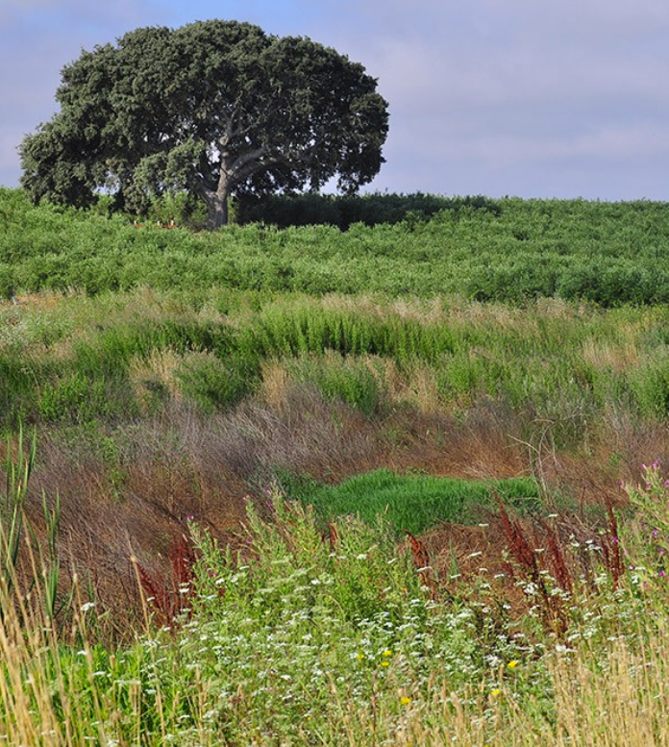
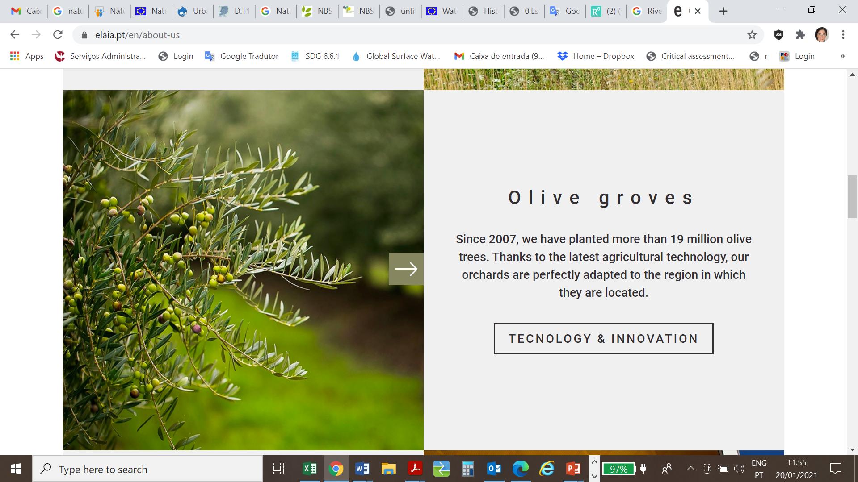


MArket uptake of an innovative irrigation Solution based on LOW WATer-ENergy consumption
MASLOWATEN - https://maslowaten.eu/?page_id=178&lang=en
Pilot installation in Alter do Chão – Portugal
https://elaia.pt/en/technology-and-innovation
80 farms,
19 million olive trees
3.300 tons of olives per day
Water Use Efficiency certificate
2.500 hectares with high ecological value are dedicated to conservation. They are comprised of natural agroforestry systems, ecological corridors and water lines and their margins.

Slide 16

Thank you!
www.cewp.eu
aimendes@uevora.pt
Twitter @ChinaEUwater
Notes:
Thank you page – web + place for additional contact info.
Change background colour by right-clicking → Edit background
Fill → colour

